Slide 1
Leading Continuous Improvement
Accountability Processes and Structures How we use student achievement to inform practice, drive improvement and create a culture of excellence.

Slide 2
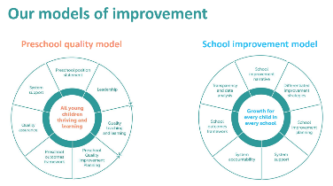
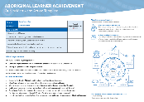
Improvement Plan Processes and Structures
Clear line of sight between sub schools starts with the power of knowledge and planning for intentionality that has a clear focus from B-12.
Clear line of sites across sub schools having an in depth knowledge of the school improvement resources and structures which support the focus and intentionality around the work that we do. These resources also help us to be intentional and clear on the lines of sight and be targeted in how we prioritise our approaches.

Slide 3
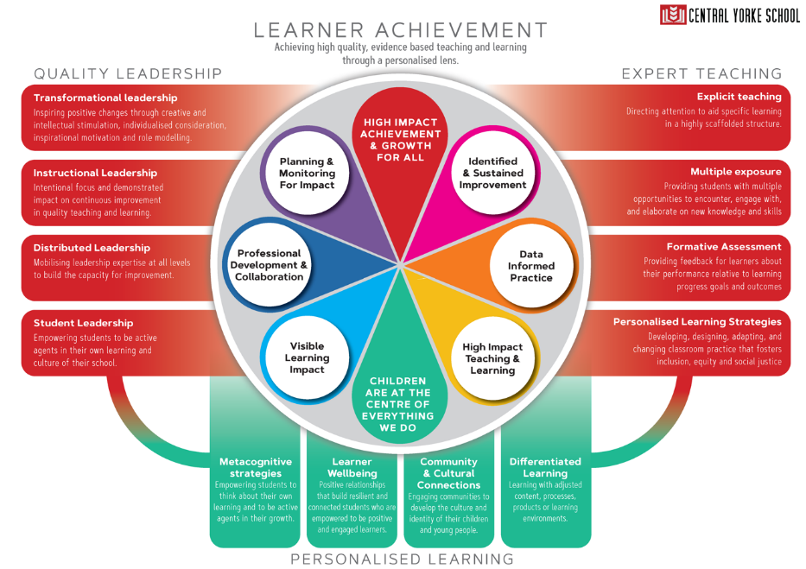
Developed whole school vision and agreement on learner achievement

Slide 4
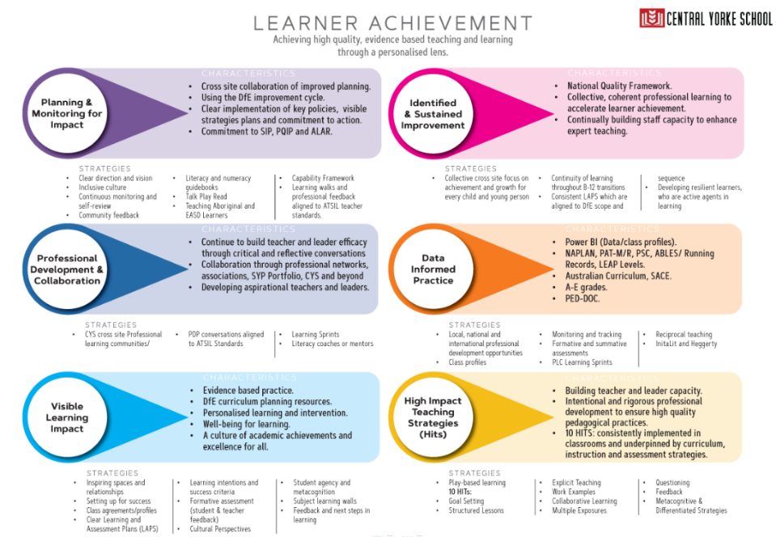

Slide 5
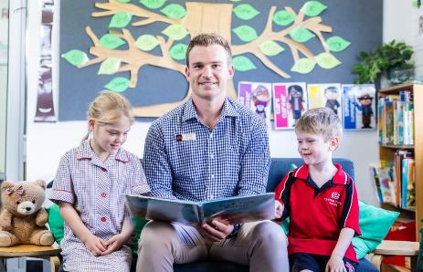
Central Yorke School
(R-12)
Improvement and Accountability

Slide 6
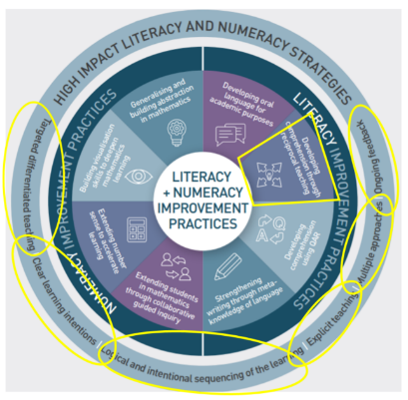
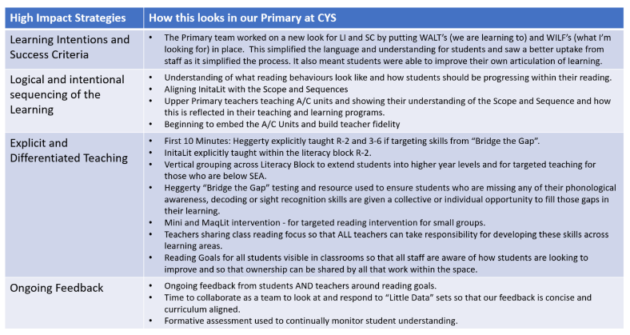
Set of non negotiable expectations around what it means to be a teacher at Central Yorke School in line with the high impact literacy strategies outlined by the Literacy and Numeracy First, Principals paper.
Each sub school has a set of non negotiables which align with the high impact literacy strategies and improvement practices. The improvement practice that we target across our B-12 site is Reciprocal Reading.

Slide 7
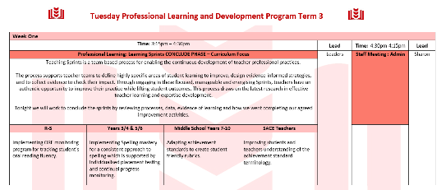
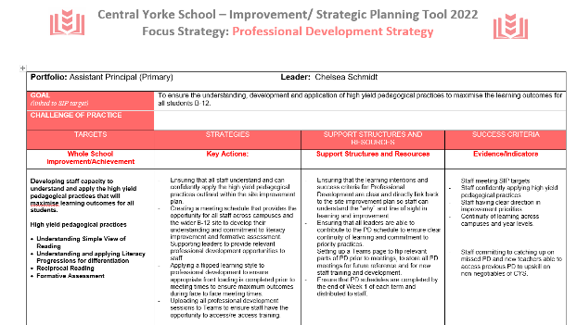
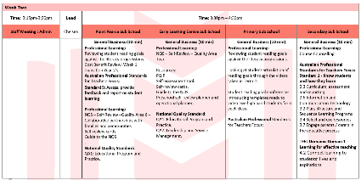
PD Program with a clear line of sight to SIP to enact expert teaching, quality leadership and approaches to personalised learning that is responsive to achieving high quality, evidence based teaching and learning.
PD Program for both campuses
B-12
Improvement and Strategic Planning Tool Professional Development Strategy which provides a clear line of site in quality leadership to expert teaching.

Slide 8
Measuring evidence of impact through data is pivotal to enact expert teaching, quality leadership and personalised learning that is responsive to achieving high quality, evidence based teaching and learning. At CYS we have a strong commitment to collecting, analysing and planning for next steps for learning and next curriculum decisions which foster personalised growth for all.
“Little Data” sets across Junior Primary and Primary contexts at CYS
Outside of the “Big Data” sets of NAPLAN, PAT, Phonics Screen Check and Running Records we also have a rigorous expectation around our “Little Data” sets.
To the left is an example of what this looks like within our JP context at Central Yorke School.

Slide 9
“Little Data” sets across Junior Primary and Primary contexts at CYS

Slide 10
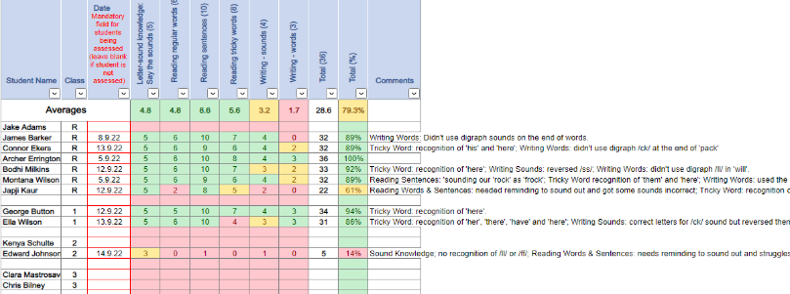
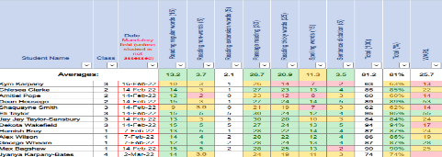
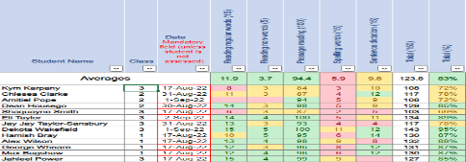
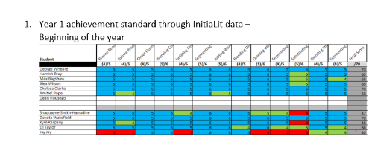
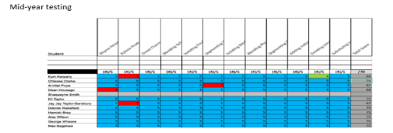
Changes in pedagogy & process:
Intentional Teaching which is responsive to student data. NLS clearly stated and visible in classroom practice. Example of this is how the InitiaLit teachers worked with our site appointed Literacy Coach to use data and organise independent activities to consolidate their learning and explicit teaching.
Evidence in the data and outcomes:
Improvement from screening tests to mid year testing.
Phonics Screen Check results only two students did not meet SEA. These two students were late enrolments to the site and had not had the explicit frontloading of IntitaLit which supports the skills in expert reading and decoding required for PSC.

Slide 12
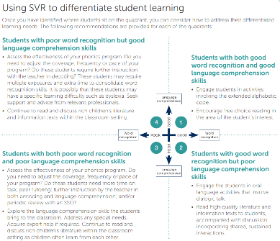
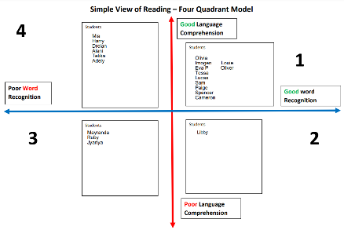
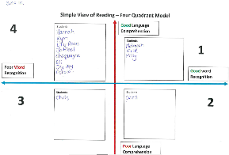
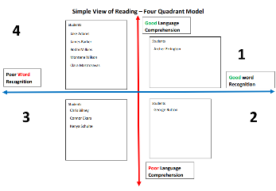
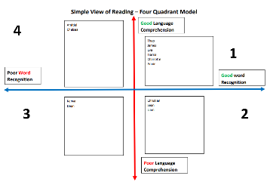
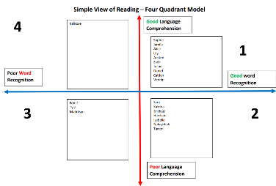

Slide 13
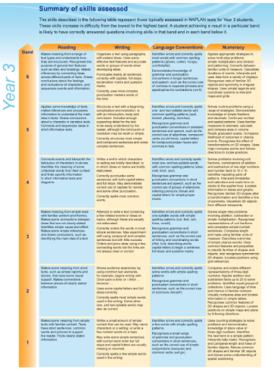
Summary of skills being assessed in NAPLAN and student mapping.
13
Understanding what skills are being assessed and what the skill increase looks like through the bands.
To make this process meaningful and student focused our Reading Goals this term will be set against the skills required in their current band or the band above their last NAPLAN result.

Slide 14
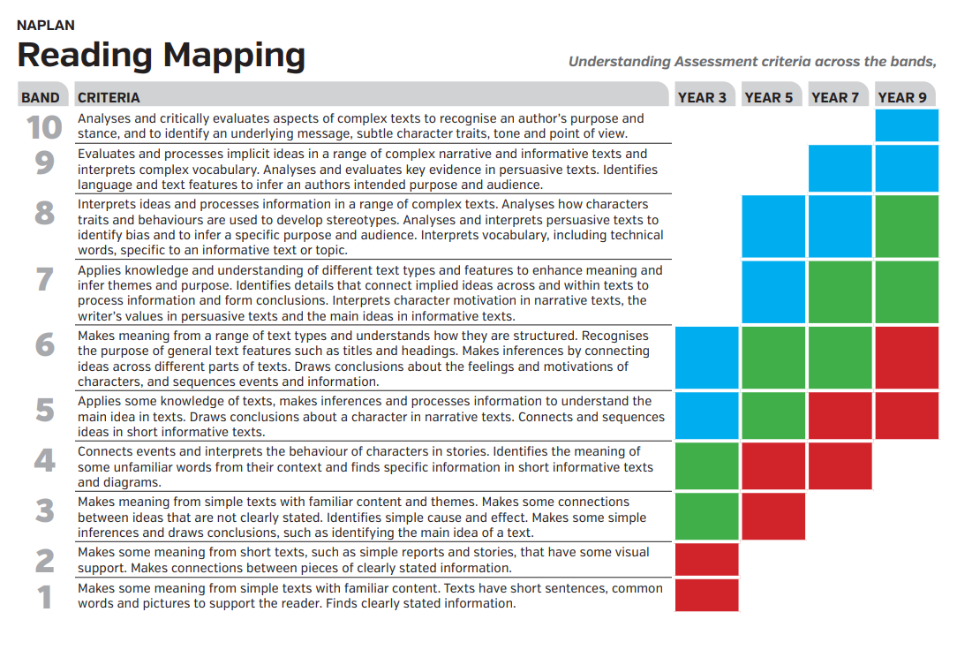

Slide 15
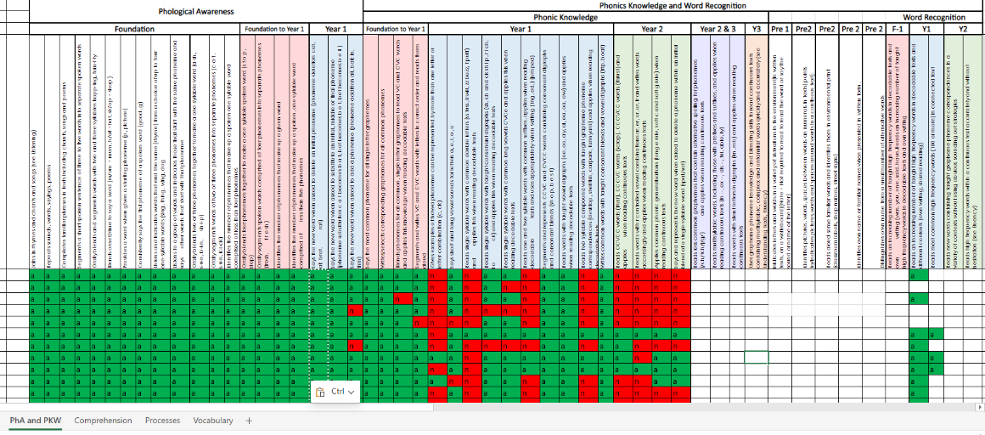

Slide 16
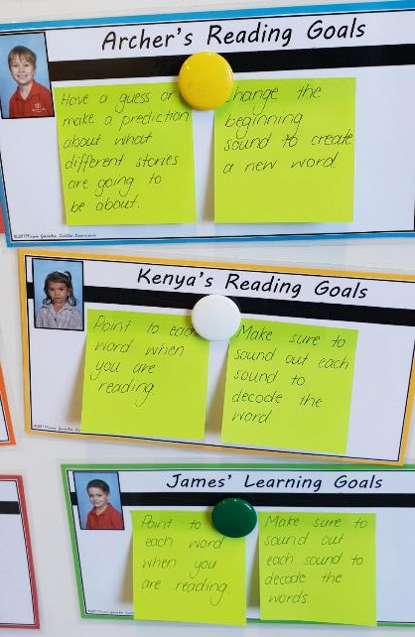
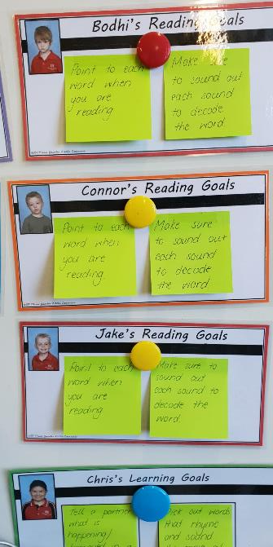

Slide 17
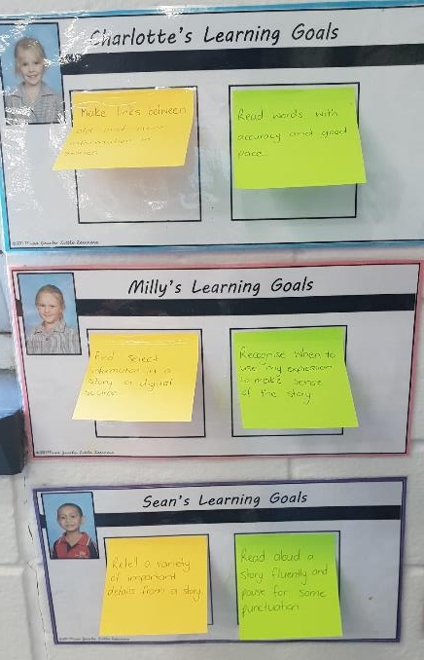
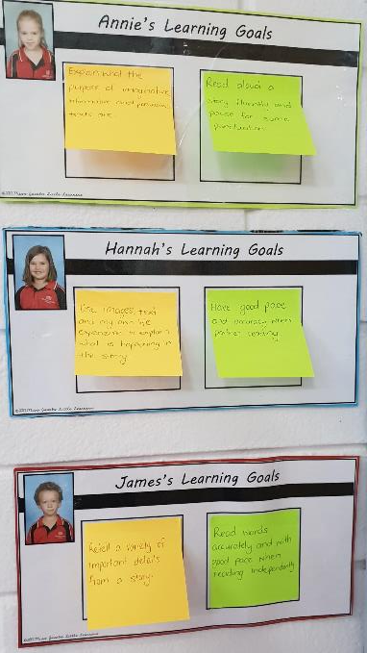
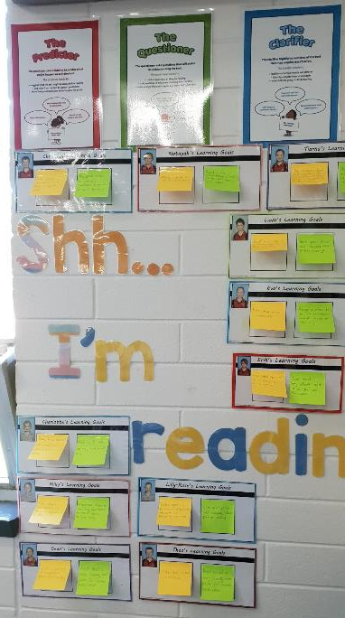

Slide 18
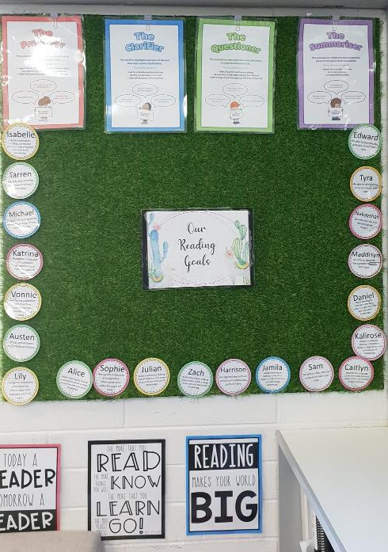
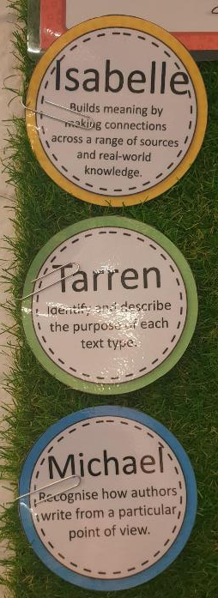

Slide 19
Group Two
(Primary and Secondary Specialist Teachers)
Step One: Understanding the literacy demands within the achievement standards.
Use the Australian Curriculum website to copy over the achievement standard from one of your focus classes/subject areas into the template.
Use the highlighting tool to highlight the literacy demands within your chosen achievement standard.
Step Two: Using the progressions to understand students and plan for differentiation.
Look at the receptive modes within the literacy progressions chose one or two which students will need to apply to successfully meet your achievement standard. Copy the summary of the receptive mode(s) into your template.
Use the literacy progressions to find the targeted skills to support students to be successful in achieving the standard within that mode. You can do this through the PDF document or the Excel spreadsheet.
Step Three: Planning the learning.
If you have mapped students against the SVR quadrants then split the group appropriately to reflect where their skills and abilities may be against the progressions. This will help inform your differentiation.
Use the template to map out how you will use this information to inform your teaching and learning. How will you differentiate the learning, entry, exit points in knowing where your students are at and what you want them to achieve against the achievement standard?
How will you know if students are getting it? How will you be assessing students or what formative assessment strategies do you plan to use?
So how can we use the progressions to inform our curriculum planning and differentiation?

Slide 21
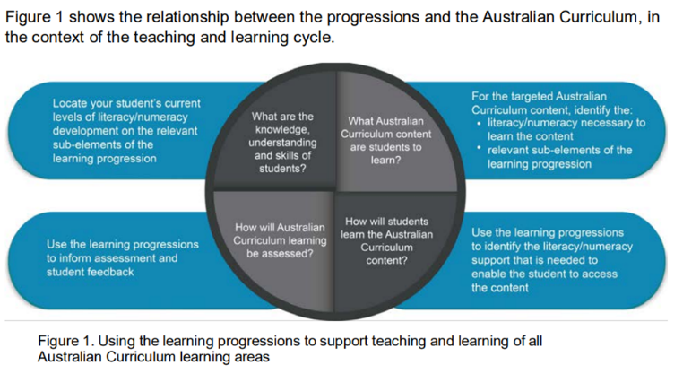
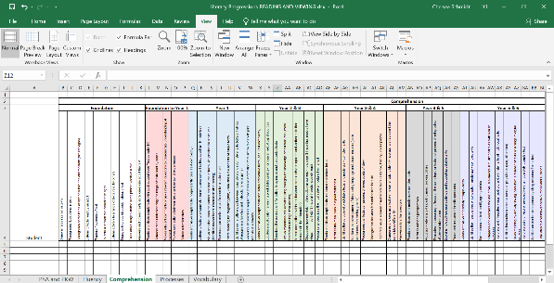
Consolidating the “Why”
If we do this…..
We will see this……

Slide 22
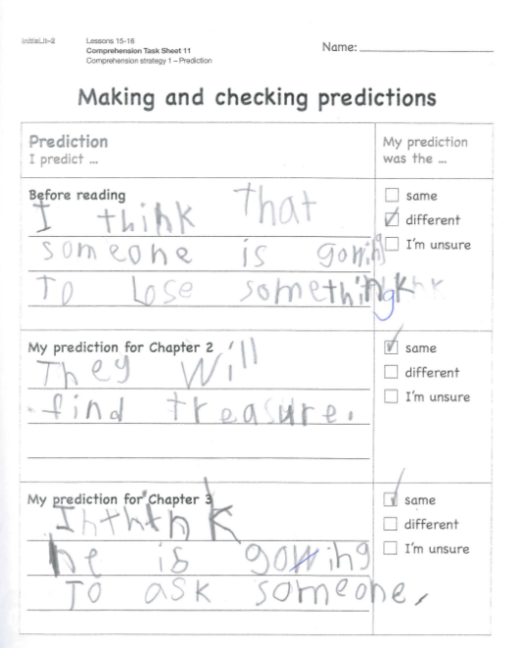
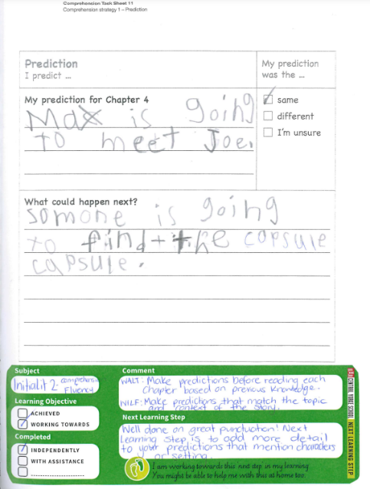
Triangulating the use of learning intentions and success criteria by making the process visible through multiple forms.
It also builds further intentionality around the process and is followed by next steps to improve learning achievement which is curriculum aligned.
The stickers also provide a platform for learning conversations with students and parents as the learning is visible throughout workbooks.

Slide 23
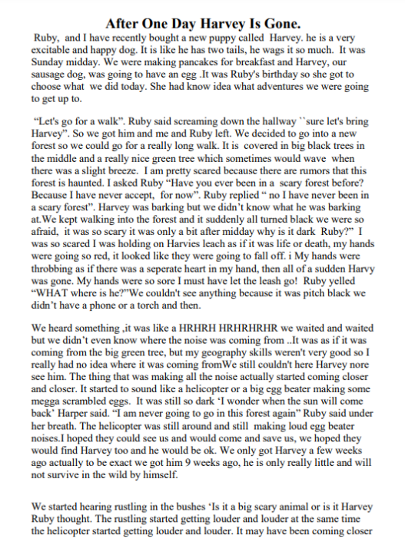
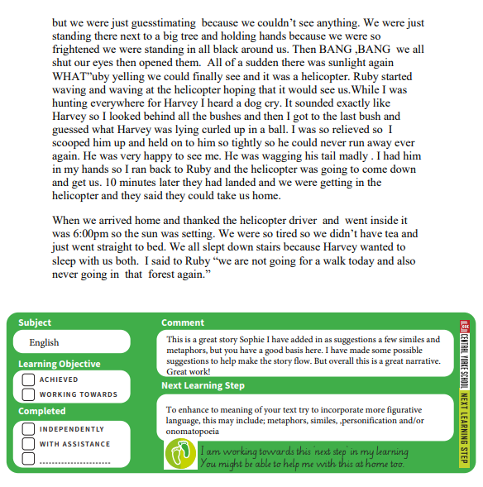

Slide 24
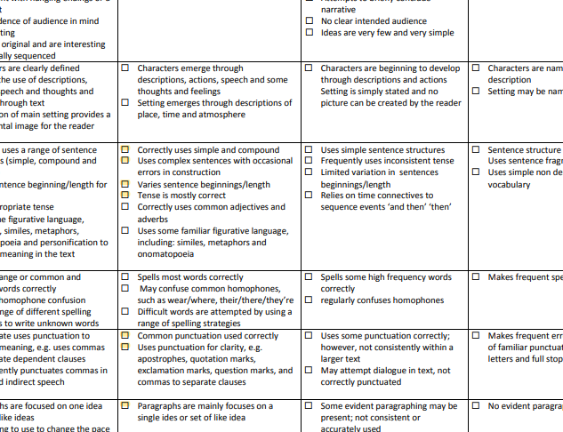
In the Upper Primary we use the same NLS stickers however these are used in conjunction with curriculum aligned rubrics which provide further feedback against assessment criteria.

Slide 25
SIP Target 2022:
To increase the number of students achieving SEA and in the higher bands for reading.

Slide 26
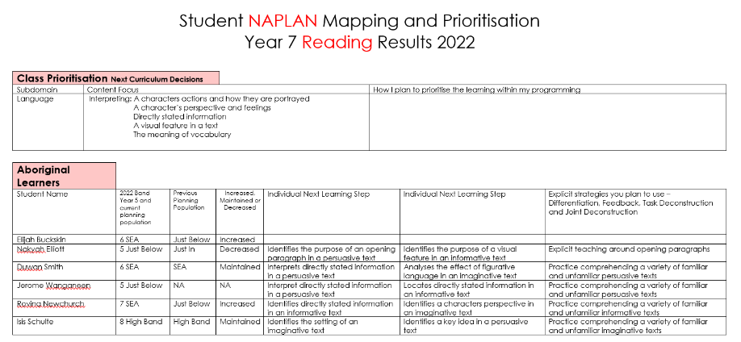
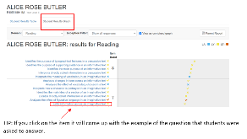
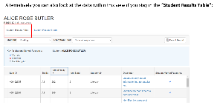
Staff then used the NAPLAN SSSR platform to explicitly reflect on the questions that students got incorrect to plan individual NLS.
They also outlined the specific strategies they plan to use to target these NLS.
Staff used the Power BI achievement profiles to fill out this section of our mapping document. It was important to be reflective of the previous planning population to reflect on the evidence of impact.

Slide 27
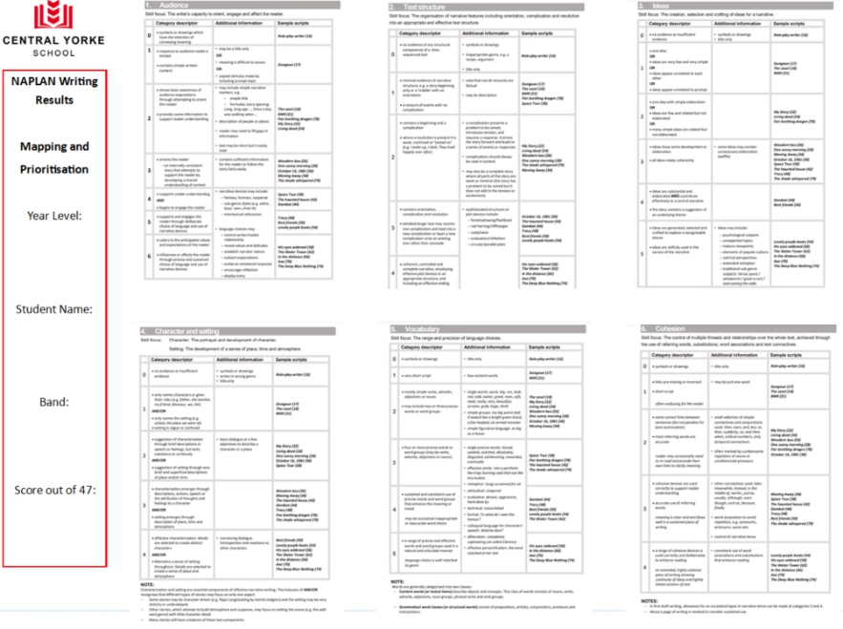
Staff used the NAPLAN SSSR platform to highlight where students scored within each aspect of the writing criteria.
Teachers then knew that the NLS within each criteria would be reflected in the band above.
This sheet was then shared with students so that they could better understand where they sat and what they needed to focus on to improve their writing moving forward.
Some teachers took this a step further by using this as a self and peer reflection tool when reading student writing samples.

Slide 28
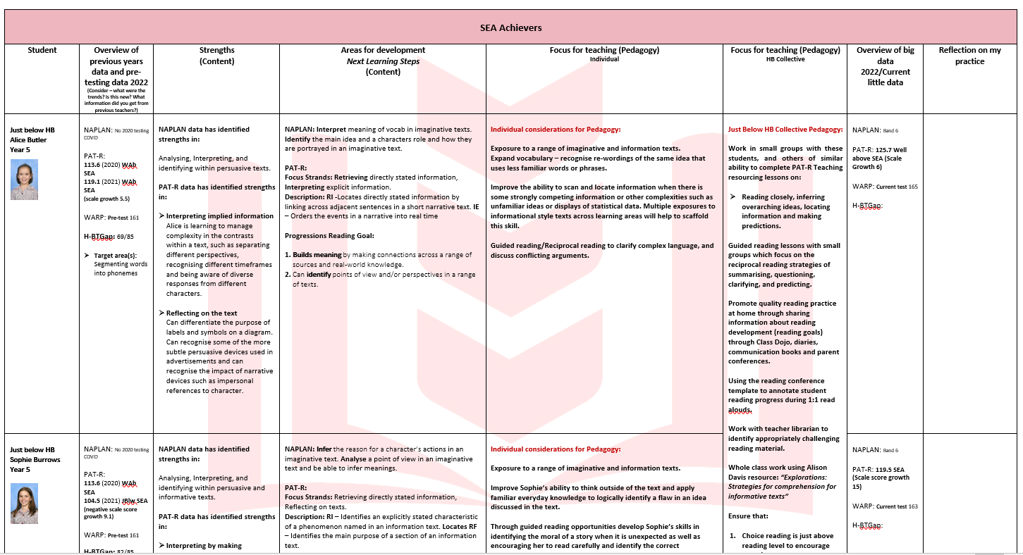

Slide 30
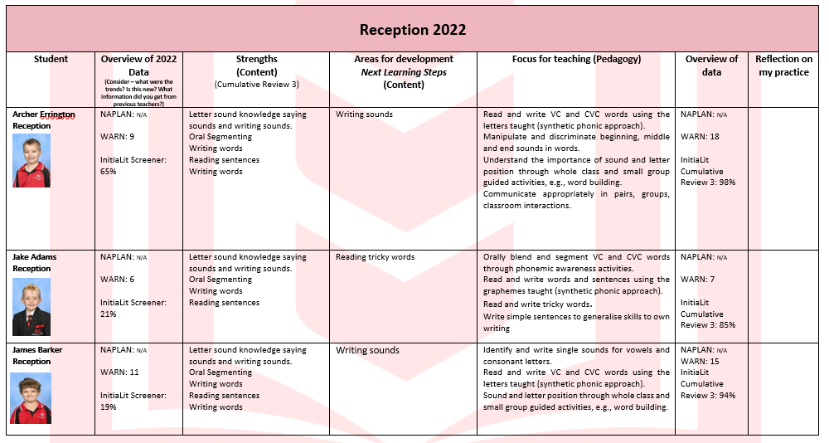

Slide 31
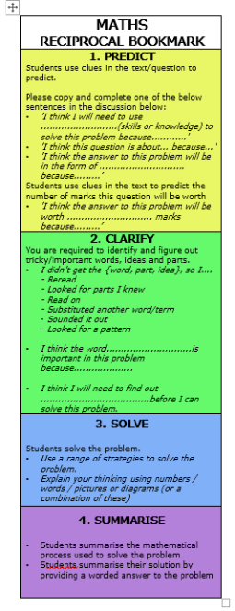
Reciprocal Teaching

Slide 32
Reciprocal Teaching Next Steps
Filming evidence of best practice for mentoring purposes
Annotating against Reciprocal Reading Rubric in Term 3 to be responsive to improving teachers fidelity and planning next learning steps.
Teacher peer observations using DfE observation tools to give feedback on the delivery of reciprocal teaching and formative assessment

Slide 33
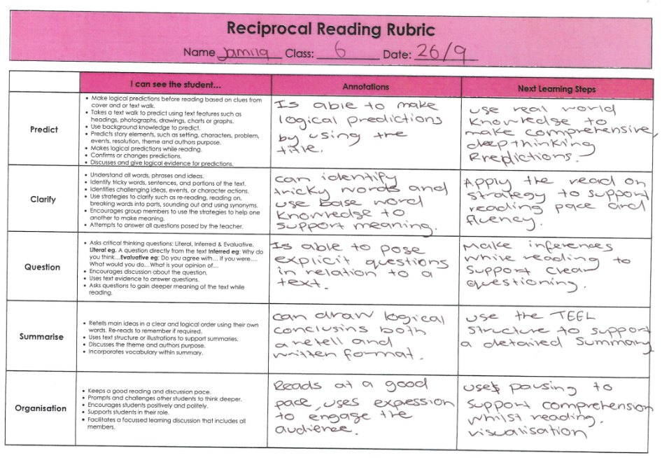
Aboriginal Learner

Slide 34
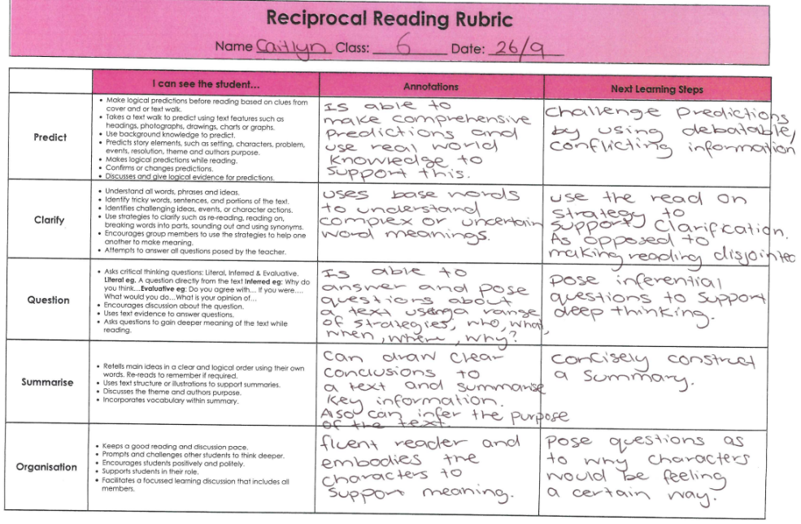
High Band Learner

Slide 35
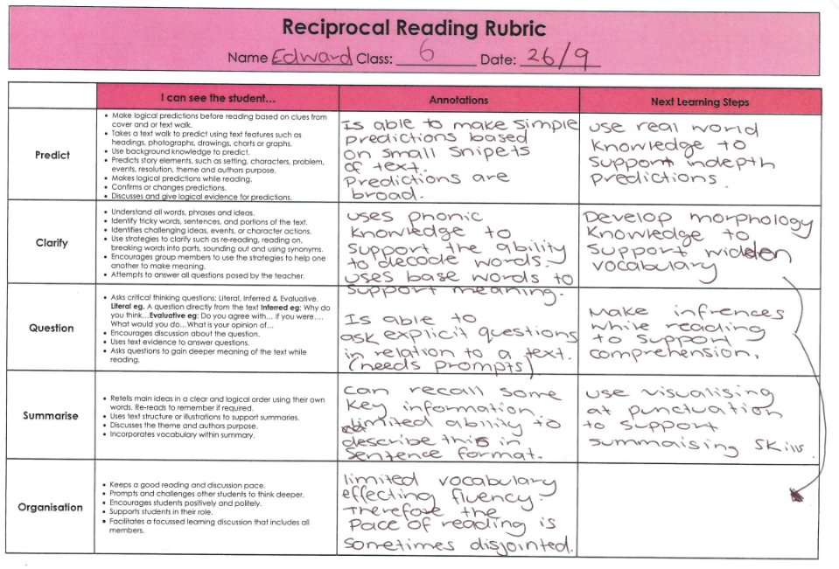
Low Band Learner

Slide 36
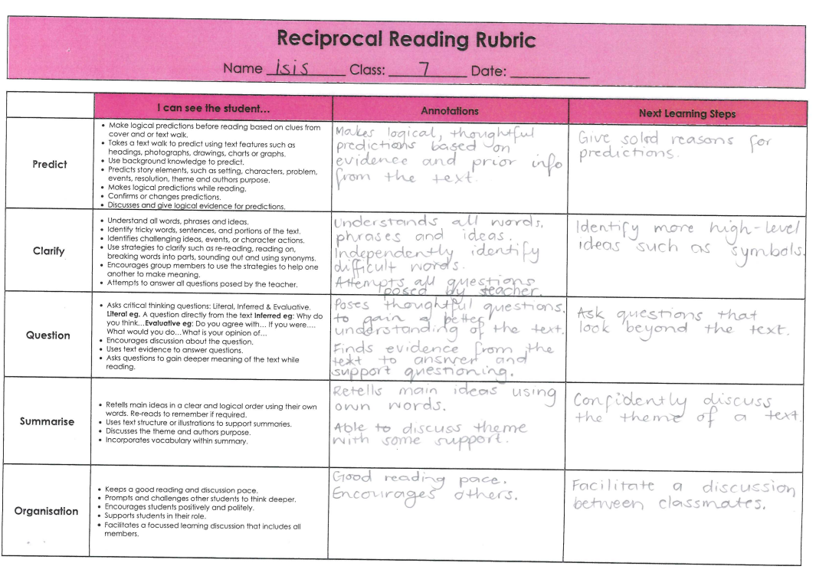
Aboriginal Learner

Slide 37
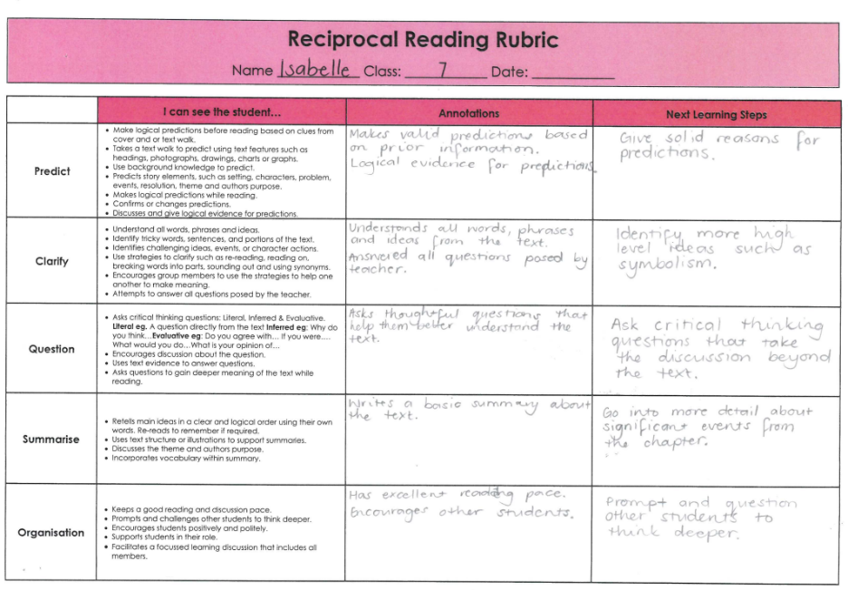
High Band Learner

Slide 38
Low Band Learner

Slide 39
Aboriginal Learner

Slide 40
High Band Learner

Slide 41
Low Band Learner

Slide 42
Transitions to build success
Kindy Transition Program

Slide 43
From Term 3 students who are eligible will attend Thursday transition sessions at CYS.
We are committed to providing learning opportunities to set children up for success. Having the balance of both high quality play based preschool programs combined with a gradual introduction to structured learning at school, with access to specialist teachers and a variety of learning areas.
Access to our early literacy program PreLit which focuses on phonological awareness and oral language development. Which is supported by the best advice paper.
Builds links with the community to become the school of choice.
Parents eager to become a part of their child's learning and wider school community.
CYS Transition to school

Slide 45
45
Oral Language Community Commitment
Chloe & Tim Program

Slide 46
Transitions to build success
Point Pearce Transition Program

Slide 47
In Term 3 our Point Pearce students in Year 2 will begin their transition to CYS by joining our morning Homeclass time and our InitaLit1 literacy blocks.
Students will travel on the bus with their siblings and have the opportunity to:
Engage in expert teaching of both IntiaLit & Heggerty with their 2023 class cohort.
Engage in morning classroom routines and circle time in line with Berrystreet models.
Begin to familiarise themselves with daily structures, routines and general expectations.
Access to regular breakfast club.
Access to school canteen at recess.

Slide 48
CYS Commitment to high quality teaching and learning for all…
Wellbeing for Learning (Secondary and Primary)
Providing personalised intervention support for both self-regulation and learning needs.
Developing social and emotional intelligence skills
Provided with interoception support strategies through the sensory room
Collaborating with interagency and outside service providers
Embedding recommendations into school learning
Learning Hub
Targeted individualised learning to support students with high complex needs
Highly structured teaching model for personal growth, development and learning outcomes

Slide 49
Primary Learning Hub

Slide 50
Wellbeing for Learning

Slide 52
Central Yorke School Early Learning Centre
(B-Age 5)
Improvement and Accountability

Slide 53
Structures
The first step of our site improvement journey for 2022, was to pull out the elements of phonological awareness from the key documents for the early years, (Early Years Learning Framework. Literacy Indicators. Literacy Guidebooks. Respect, Reflect, Relate. Talk, Play, Read resource. This formed the basis of all our curriculum decisions and data collection to meet our success criteria in the PQIP.
All educators collect anecdotal data such as photographs, work samples, and observations to form the basis of our pedagogical documentation.
The analysis of children’s pedagogical documentation identifies children’s growth within their individual goal and to critically reflect on educator practice. This informs the next steps for each child through an individual learning goal and the educator practice to target both individuals and groups of children. This is our process for formative assessment and drives our curriculum decisions.
The analysis of teaching and learning is then shared with families to gain their feedback and perspective about their child and their learning.

Slide 55
Providing high quality personalised teaching and learning for all

